Slide 1


Slide 2
PROJECT TEAM COMMUNICATION

Slide 3
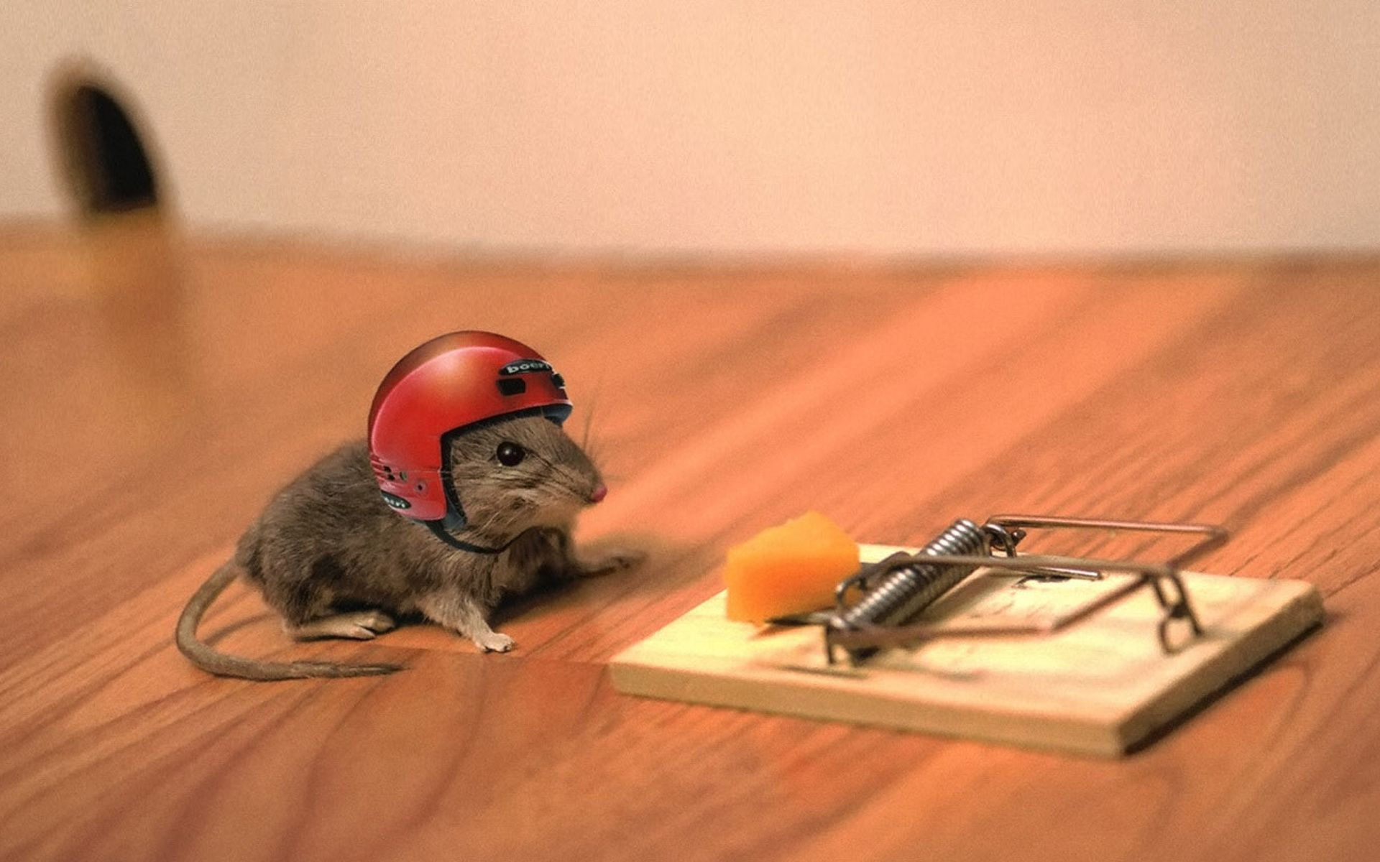
One day, a little mouse living on a farm, spied the farmer and his wife opening a package. He was aghast to discover that the package contained, not food, but a mouse trap. The mouse ran to the farmyard warning everyone.
“There is a mouse trap in the house, there is a mouse trap in the house…!!!”

Slide 4

The chicken raised his head and exclaimed, “Mr. Mouse, I can tell you this trap is a grave concern to you, but it has no consequence to me and I cannot be bothered with it.”

Slide 5

The mouse then turned to the bull… “Sounds like you have a problem Mr. Mouse, but not one that concerns me.”

Slide 6
The mouse returned to the house, dejected that no one would help him or was concerned about this dilemma. He knew he had to face the trap on his own.

Slide 7

That night the sound of a trap catching its prey was heard throughout the house. The farmer’s wife rushed to see what was caught. In the darkness she could not see that it was a venomous snake whose tail the trap had caught. The snake bit the farmer’s wife.

Slide 8

The wife caught a bad fever and the farmer knew the best way to treat a fever was with the chicken soup. He took his hatchet to the farmyard to get the soup’s main ingredient.

Slide 9

But unfortunately farmer’s wife got worse and died. So many friends and family came to her funeral that the farmer had to slaughter the bull to feed them all.

Slide 10
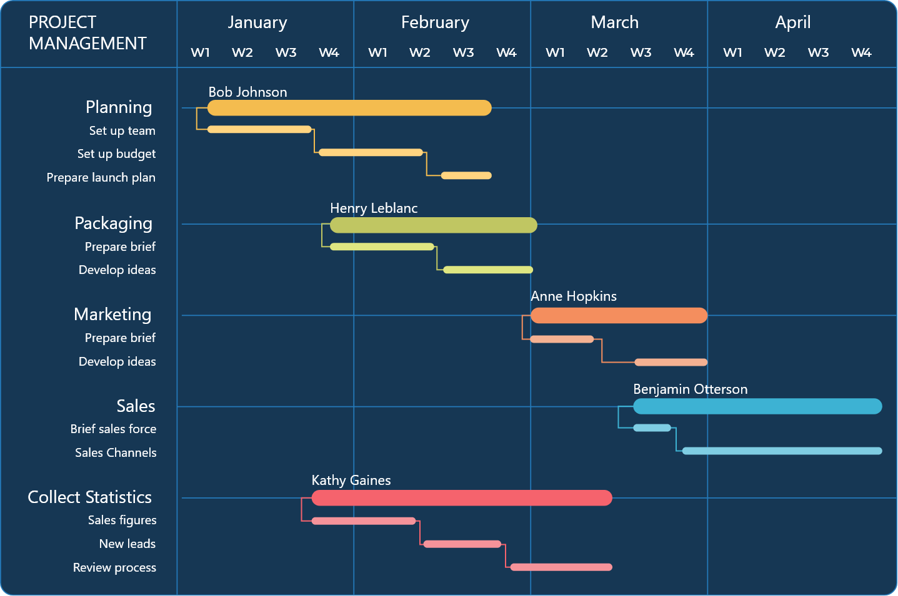

Slide 11
What is Communication
  Communication includes both the transference and the understanding of meanings.
  An idea, no matter how great, is useless until it is transmitted and understood by others.
  Communication can also be termed as the exchange of thoughts between two or more people, groups or organizations, verbally, through symbols, or in writing.

Slide 12
Functions of Communication
There are four major functions of communication:
Control member behavior:
  Organizations have the authority hierarchies and formal guidelines that employees follow.
  When work groups tease or harass a member who produces too much, they are informally communicating with, and controlling, the member’s behavior.
Foster motivation for what is to be done:
  Communication fosters motivation by clarifying to employees what is to be done, how well they are doing, and what can be done to improve performance.
  The formation of specific goals, feedback on progress toward the goals, and reinforcement of desired behavior all stimulate motivation & communication.

Slide 13
Functions of Communication
Provide a release for emotional expression:
  Communication provides a release for the emotional expression of feelings and for fulfillment of social needs. For many employees, their work group is a primary source for social interaction.
Provide information needed to make decisions:
  Communication facilitates decision making. It provides information by transmitting the data to identify and evaluate alternative choices.

Slide 14
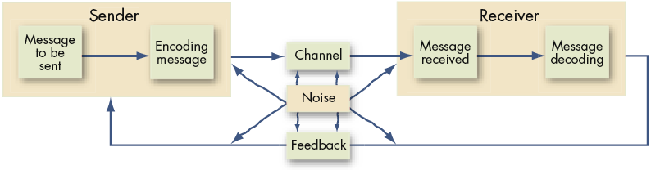
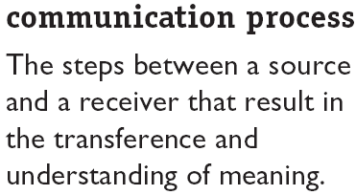
The Communication Process / Model

Slide 15
Important Message Related Terms
Message. What is to be communicated.
Encoder. Who sends the message.
Encoding. Converting a communication message to symbolic form.
Channel. The medium through which a communication message travels.
Receiver. Who receives the message.
Decoding. Translating a sender’s communication message.
Feedback Loop. The final link in the communication process; put the message back into the system as a check against misunderstanding.

Slide 16
Direction of Communication
Downward:
  Communication that flows from top level of a group organization to a lower level.
  This is typically what we think of when managers communicate with workers. Its purpose is to assign goals, provide instructions, communicate policies and procedures, provide feedback. It does not have to be face to face or an oral communication.
Upward:
  Upward communication flows to a higher level in the group or organization.
  It is used to provide feedback to higher-ups, inform them of progress, and relay current problems e.g. performance (reports prepared by lower management), suggestion boxes, employee attitude surveys, etc.

Slide 17
Direction of Communication
Lateral:
When communication takes place among members of the same work group, among members of work groups at the same level, among managers at the same level.
Horizontal communications are often necessary to save time and facilitate coordination.
They can create dysfunctional conflicts
when the formal vertical channels are
breached, when members go above or
around their superiors to get things
done, or when bosses find out that
actions have been taken or decisions
made without their knowledge.
Downward
Lateral
Upward

Slide 18
Interpersonal Communication
Oral Communication. Oral communication is the chief means of conveying messages. Speeches, formal one on one and group discussions, and informal rumor mill or grapevine are popular forms of oral communication.
  Advantages: Speed and feedback.
  Disadvantage: Distortion of the message.
Written Communication. Written communications include memos, letters, electronic mail, faxes, periodicals, bulletin boards, etc.
  Advantages: Tangible and verifiable.
  Disadvantages: Time consuming and lacks feedback.

Slide 19
Interpersonal Communication (Cont’d)
Nonverbal Communication. We send a nonverbal message every time we send a verbal one. At times the nonverbal message may stand alone. They include body movements, facial expressions, and the physical distance between sender and receiver. We use body language to convey a message and typically do unconsciously.
The two most important messages body language conveys is the extent to which an individual likes another and is interested in his or her views and the relative perceived status between sender and receiver.
  Advantages. Supports other communications and provides observable expression of emotions and feelings.
  Disadvantage. Misperception of body language or gestures can influence receiver’s interpretation of message.

Slide 20
Interpersonal Communication (Cont’d)
Kinesics:
Kinesics is the study of body motions. It refers to gestures, facial configurations, and other movements of the body.
We acknowledge that body movement is an important segment of the study of communication and behavior, conclusions must be necessarily guarded.
It has been argued that every body movement has a meaning and that no movement is accidental. For example, through body language, We say, “Help me, I’m lonely. Take me, I’m available. Leave me alone, I’m depressed.”

Slide 21
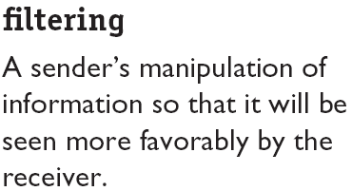
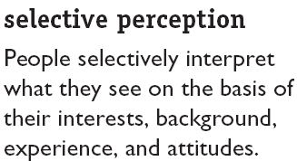
Barriers to Effective Communication
The more levels in an organization’s structure, the more opportunities there are for filtering. Being reluctant to give bad news, or trying to please one’s boss distort upward communications.
Receivers project their interests and expectations into communications as they decode them.

Slide 22
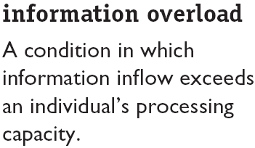
Barriers to Effective Communication (cont’d)
The result is individuals tend to select out, ignore, pass over, or forget information. Or they may put it aside until the overload situation is over. The result is lost information and less effective communication.
Defensiveness:
It refers to the situation when people engage in behaviors such as verbally attacking others, making sarcastic remarks, being overly judgmental, and questioning others motives.
When people feel that they are being threatened, they tend to react in ways that reduce their ability to achieve mutual understanding.

Slide 23
Barriers to Effective Communication (cont’d)
Language:
Words have different meanings to different people.
Individuals interpret word meanings different ways. For example, incentives and quotas are often perceived as implying manipulation causing resentment among lower levels of the organization.
Use of Jargons:
Specialized terminology or technical language that members of a group use to aid communication among themselves.
While communicating with people from different cultures, due care is to be taken to ensure that only those terminologies/ words should be used, which they clearly understand, e.g. Own money, Stand easy, BZ etc.

Slide 24
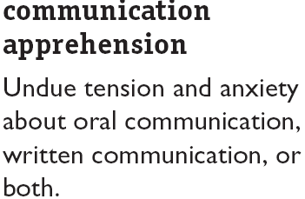
Barriers to Effective Communication (cont’d)
Team members may find it difficult to talk with others face to face, on the telephone or may be unable to correctly express themselves in writing.

Slide 25
PROJECT COMMUNICATION MANAGEMENT

Slide 26
Importance of Communication in Projects
The greatest threat to many projects is a failure to communicate with each other.
Project Managers must be able to communicate effectively to succeed in their positions.
Strong verbal skills are a key factor in career advancement for Project Managers.
Networking culture encourages exchange of ideas and skills (Sharing is Caring).

Slide 27
Project Communication Management
Various dimensions:
Following are the various dimensions of project communication:
Internal – within organization or project
External – with external stakeholders
Formal – organization regarind e-mails, reports, meetings, briefings, presentations
Informal –personal emails, social media, website, discussions
Hierarchical focus – Upward, downward, horizontal
Official – Annual reports to regulators / Govt.
Unofficial – Information generated to build strong relationship between project team & various stake holders.

Slide 28
5 Cs Now of Written Communication
Correct Grammar and Spellings
Concise expression and elimination of excess words
Clear purpose directed to needs of stakeholders
Coherent, logical flow of ideas
Controlling flow of words and ideas

Slide 29
7 Cs of Communication
The 7 Cs are the more comprehensive and widely cited list, providing a checklist to optimize your message. They are:
Clear: The message should be easily understandable and the purpose should be immediately apparent. Avoid jargon and ambiguity.
Concise: Get to the point in the fewest possible words. Avoid repetition and unnecessary detail to save time for both the sender and the receiver.
Concrete: The message should be specific, factual, and backed by data or examples. Avoid vague language and generalizations.
Correct: Ensure the message is free from errors in grammar, spelling, punctuation, and, most importantly, factual information.
Coherent (or Cohesive): The message must be logical, well-organized, and all points should relate to the main topic. The flow of ideas should be natural and easy to follow.
Complete: The message must include all the necessary information the receiver needs to take action or understand the main point fully. Answer the 5 Ws and 1 H (Who, What, Where, When, Why, and How) where applicable.
Courteous (or Consideration): Maintain a friendly, respectful, and professional tone. Be empathetic, consider the receiver's viewpoint, and use positive language.

Slide 30
Trends and Emerging Practices of Project Communication Mgt
Inclusion of project stakeholders in project reviews – individuals, groups & organizations essential for project delivery.
Inclusion of stakeholders in project meetings – important features, progress, likely problems, are discussed with stakeholders.
Increased use of social computing – use of public IT infrastructure to necessary collaboration and strong networking with project stakeholders.
Multifaceted approaches to communication – social media and other advanced computing technologies may be used according to culture and local practices.

Slide 31
Project Communication Management Process
Plan Communications Management. The process of developing an appropriate approach and plan for managing various communication activities based on the needs of various stakeholders, both within and outside the project / organization.
Manage Communications. The process of ensuring timely & appropriate collection, creation, distribution, storage, retrieval, management, monitoring and ultimate disposal of project information.
Monitor Communications. To ensure that all information needs of the project and its stakeholders are suitably met.

Slide 32
Project Communications Management Process
Communications planning: determining the information and communications needs of the stakeholders.
Information distribution: making needed information available in a timely manner.
Performance reporting: collecting and disseminating performance information.
Administrative closure: generating, gathering, and disseminating information to formalize phase or project completion.

Slide 33
Communications Planning
Every project should include some type of communication management plan, a document that guides project communications.
Creating a stakeholder analysis for project communication also aids in communication planning.

Slide 34
Communication Management Plan
A description of a collection and filing structure for gathering and storing various types of information.
A distribution structure describing what information goes to whom, when, and how.
A format for communicating key project information.
A project schedule for producing the information.
Access methods for obtaining the information.
A method for updating the communications management plans as the project progresses and develops.

Slide 35
Communication Planning
Communications Requirements: Sum of information requirements of project stakeholders:
Project organization and stakeholder responsibility relationships.
Disciplines, departments, and specialties involved in the project.
Logistics of how many individuals will be involved with the project and at which locations.
External information needs.

Slide 36
Communication Planning
Communications Technology: methods used to transfer information back and forth among project elements:
Immediacy of the need for information.
Availability of technology.
Expected project staffing.
Length of the project.

Slide 37
Communication Planning
Constraints:
Constraints are factors that will limit the project management team’s options.
When a project is performed under contract, there are often specific contractual provisions that affect communications planning.

Slide 38
Communication Planning
Assumptions:
Assumptions are factors that, for planning purposes, will be considered to be true, real, or certain.
Assumptions generally involve a degree of risk.
They may be identified here or may be an output of risk identification.

Slide 39
Information Distribution
Getting the right information to the right people at the right time and in a useful format is just as important as developing the information in the first place.
Important considerations include:
  Using technology to enhance information distribution
  Formal and informal methods for distributing information

Slide 40
Information Distribution
Work Results: outcomes of activities performed to accomplish the project.
Project Plan: it is a formal, approved document used to manage and control project execution.

Slide 41
Tools and Techniques for ID
Communications Skills are essential to exchange information. Sender is responsible for making the information clear and complete so that receiver can receive it correctly. Receiver is responsible for making sure that information is received in its entirety and understood correctly. Its dimensions are:
  Written and oral, listening and speaking.
  Internal and external sharing.
  Formal and informal reports.
  Vertical and horizontal linkups.

Slide 42
Tools and Techniques for ID
Information can be shared by team members through a variety of methods including manual filing systems, electronic text databases, project management software, and systems which allow access to technical documentation such as engineering drawings.
Information may be distributed using meetings, document distribution, shared access to networked electronic databases, fax, electronic mail, voice mail and video conferencing.

Slide 43
Output from Information Distribution
Project records may include correspondence, memos, reports, and documents describing the project.
This information should, to the extent possible and appropriate, be maintained in an organized fashion.
Project team members may often maintain personal records in a project notebook.

Slide 44
Performance Reporting
Performance reporting keeps stakeholders informed about how resources are being used to achieve project objectives:
  Status reports describe where the project stands at a specific point in time.
  Progress reports describe what the project team has accomplished during a certain period of time
  Project forecasting predicts future project status and progress based on past information and trends
  Status review meetings often include performance reporting

Slide 45
Administrative Closure
A project or phase of a project requires closure;
Administrative closure produces:
  Project archives – historical record of project achievements.
  Formal acceptance – acceptance by client.
  Lessons learned – lessons shall act as feedback.

Slide 46
Thank You

